Slide 1
Innovative test solution
Provider
- Probe pin Datasheet -

Slide 2
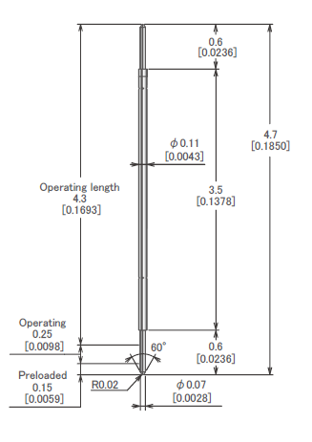
※ POGO type – 0.2 pitch
IVB-SCR-470-011-A229-00
Pitch | 0.2mm
Total Length | 4.7mm
Use Length | 4.3mm
Recommended Stroke | 0.4mm
Max Stroke | 0.5mm
Spring Force at Use Stroke | 6.0gf at 0.4mm Stroke
Operating Temperature | -40 to 120°C
DC Resistance | Avg. 500mΩ at 0.4mm stroke
Current Rating | 0.2A
Self Inductance | 1.72nH
Bandwidth @ -1dB | 9.8GHz
Capacitance | TBD
Top Plunger | Pd Alloy
Bottom Plunger | Pd Alloy
Barrel | Alloy
Spring | Music Wire / Au over Ni
Insertion Life | 100,000 cycles at 0.4mm Stroke

Slide 3
Thank you.

